Slide 1
New, completely original title
Adding a randomly generated number here: -0.552489289397709

Slide 2
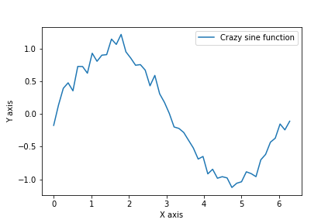
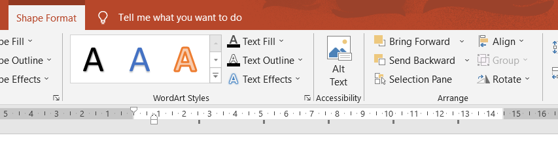
This is another slide
To open the Selection Pane and see variable names:
Select any shape in the slide
A “ Shape Format” tab will appear
On it, there will be a “Selection Pane” button on the “Arrange” menu
Look at the graph below:

